Slide 1
Explore how Einstein Vision can help categorize your photos
Phil Bergner, Product Architect
@phillleebe

Slide 2
Phil Bergner
Youreka Product Architect
Salesforce developer for 7 years with Synaptic AP
Architect for a forms and field service application: Youreka
http://www.youreka.io
Utilizes Einstein to help customers in the field classify photos automatically via our mobile app

Slide 3

What you’ll learn today
What is Einstein Vision?
How to prepare photos, upload photos, and train Einstein
A quick demo of Einstein Vision in action!
Next steps you can accomplish on your own

Slide 4
What is Einstein Vision?
The Einstein Vision API allows you to classify photos based on your own categorized images.
You upload categorized sample images
You run a few commands to train Einstein
You’re done! Now you can send images via an API callout and get back results!

Slide 5
How can I use it?
Let’s consider how it may be useful in several industries:
Expedite site inspections – an on-site inspector could classify mold immediately
Product compliance –verifying brand compliance or product placement
Assist field service technicians – a technician could classify parts, or quickly check inventory for a specific part

Slide 6
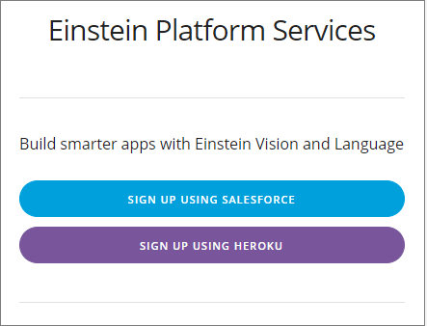
1. Register
First we need to create a user for Einstein https://api.einstein.ai/signup
After registering you’ll be provided a RSA Private key.
Since this user is for DEMO/TESTING ONLY you can copy the key and all of its text to a text file for now.

Slide 7
2. Install an unmanaged package to get started
https://github.com/pbergner/df18-einstein-vision
Note: this package includes bootstrap code to help get you up and running quickly as well as other assets from this presentation

Slide 8
3. Take lots and lots of photos!
This is your chance to prove you really are the amateur photographer you say you are on your online dating profile
Create a folder for each photo category and upload sample photos to each
Photo Tips
Include a wide variety of images
Lots of different angles and backgrounds
Color and black&white
Blurred
That contain objects it might typically be seen with

Slide 9
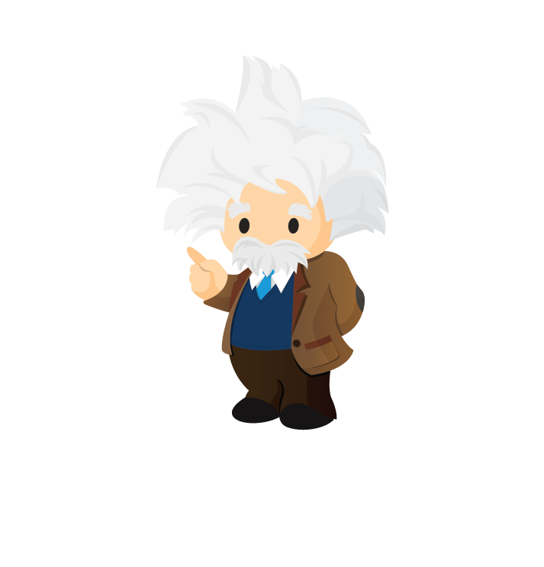
Time to Train Einstein
Yes we can teach him a thing or two.

Slide 10
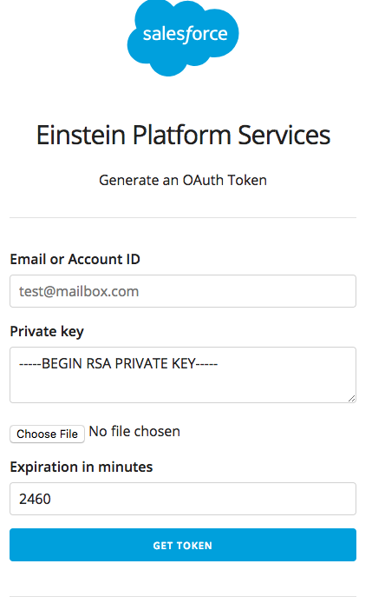
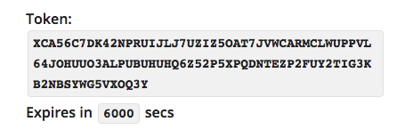
4. Generate an OAuth Token
You only need to do this to train the model. The unmanaged package will handle this going forward
https://api.einstein.ai/token
Enter your email address and paste in the key from earlier
You don’t need to upload a file since we’re pasting the key in
Set the expiration time
It will then generate a token you can copy into a text file for now.

Slide 11
5. Upload your photos to Einstein
Put on your hacker hat, we’re going in!
Does using the command prompt make you cooler?
Yes
Upload your photos to Einstein
ZIP up your folders containing your sample photos
Open a command prompt and consult the Einstein cheatsheet (link) for the UPLOAD command.
Replace the Bearer token with the token we just copied from the previous slide. Replace the path with the local path to your ZIP file.
Click enter!

Slide 12
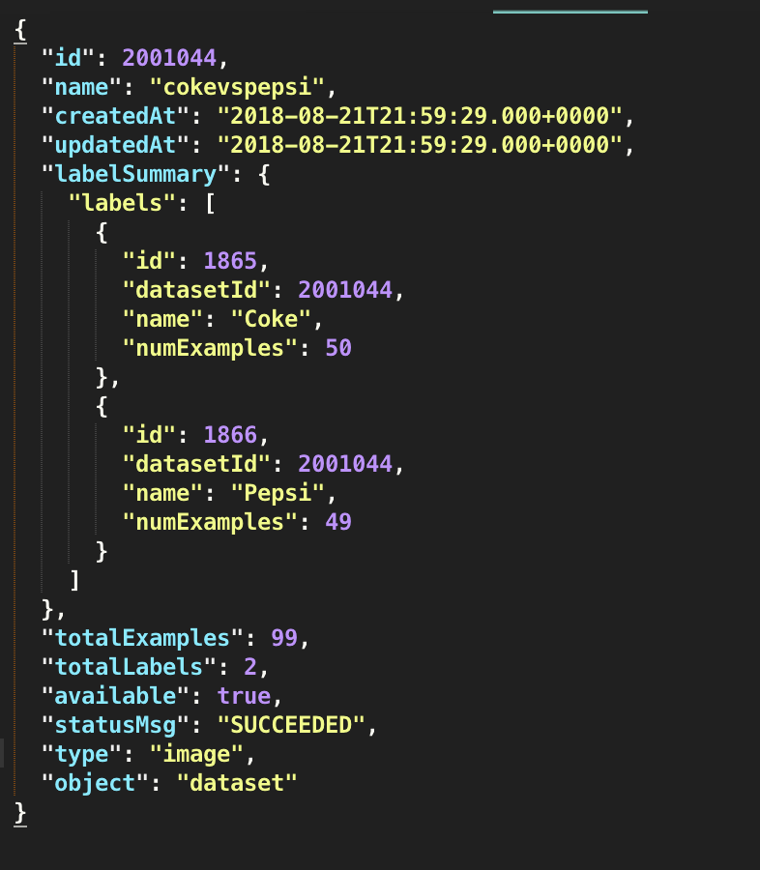
6. Copy your dataset ID from the result
Your result may not be formatted this nicely, but the ID is repeated several times.

Slide 13
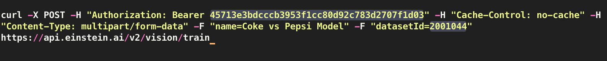
7. Train your Dataset
Einstein isn’t that smart….yet
Train your dataset now that it has your sample photos
Open a command prompt and consult the Einstein cheatsheet (link) for the TRAIN command.
Replace the Bearer token with the token just like before. Give the model a name. Replace the sample datasetId with the one we just received.
Click enter!

Slide 14
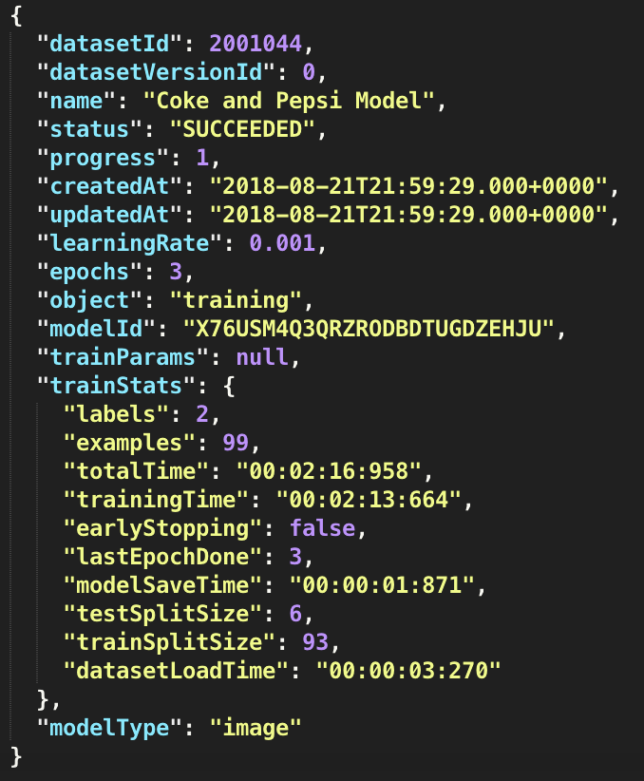
8. Copy your model Id from the result
This is the model Id you’ll be using to test your photos! Copy it and put in a safe place, like your sock drawer next to your Pokémon cards.

Slide 15
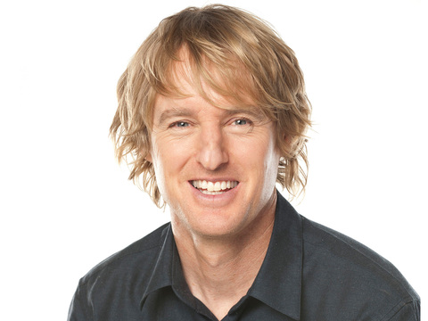
What did we do?
A quick recap of training Einstein
Wow
UPLOAD Images
DATASET ID
TRAIN Dataset
MODEL ID

Slide 16
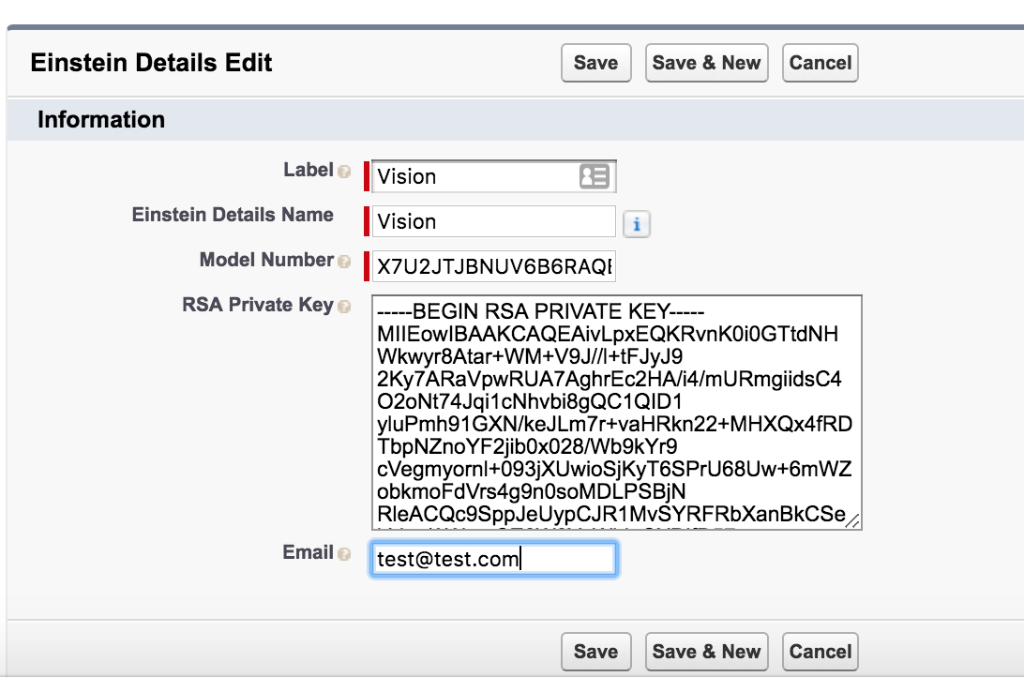
Navigate to the Einstein Details Custom Metadata
I’ve created a handy custom metadata type to store our Id and key.
Paste in your RSA Key, Model Id, and Email.

Slide 17
Time to test it out!
For the purpose of this demo I’ll play the role of a field service technician performing a residential dryer repair.

Slide 18
Next Steps
I’ve included a method for using the Feedback API
That’s right you can teach it to get smarter the more you use it!
For a challenge, try adding a button to the page to tell Einstein if it was correct or not. Use the method I provided to make the API call.
Once you’ve given it a good amount of feedback use the RETRAIN command from the cheatsheet to generate a smarter model!

Slide 19

Thank you!
This was an example of how simple it can be to configure Einstein Vision with your OWN photos and immediately begin using it.
https://github.com/pbergner/df18-einstein-vision
Includes:
Einstein command cheatsheet
Slidedeck
Trailhead links
Einstein API links
Credit to René Winkelmeyer for building the Apex Einstein wrapper functionality.
Phil Bergner Youreka Product Architect phil.bergner@synapticap.com @philleebe

